Slide 1
Overcoming Objections to Faith
Evolution Explains Life – Who Needs God?

Slide 2
Evolution vs. Creation
Similarities
Differences
Both attempt to explain how we got here.
Neither were observed by man.
Neither can be definitively proven.
Both require faith.
Creator versus chance.
Life begets life versus non-life producing life
Radically different worldviews emerge from the two.

Slide 3
What Does the Bible Say?
Genesis
  1:1 “In the beginning God created the heavens and the earth.”
  2:7 “the LORD God formed the man from the dust of the ground and breathed into his nostrils the breath of life, and the man became a living being.”
  5:1,2 “When God created man, he made him in the likeness of God. 2 He created them male and female and blessed them. And when they were created, he called them "man.”

Slide 4
What Does the Bible Say?
Deuteronomy
  4:32 “Ask now about the former days, long before your time, from the day God created man on the earth; ask from one end of the heavens to the other. Has anything so great as this ever happened, or has anything like it ever been heard of ?”

Slide 5
What Does the Bible Say?
Nehemiah
  9:6 “You alone are the Lord. You made the heavens, even the highest heavens, and all their starry host, the earth and all that is on it, the seas and all that is in them. You give life to everything, and the multitudes of heaven worship you.”

Slide 6
What Does the Bible Say?
Psalms
  90:2 “Before the mountains were born or you brought forth the earth and the world, from everlasting to everlasting you are God.”
  102:25 “In the beginning you laid the foundations of the earth, and the heavens are the work of your hands.”
  148:3-5 “Praise him, sun and moon, praise him, all you shining stars. Praise him, you highest heavens and you waters above the skies. Let them praise the name of the Lord, for he commanded and they were created”

Slide 7
What Does the Bible Say?
Isaiah
  45:12 “It is I who made the earth and created mankind upon it. My own hands stretched out the heavens; I marshaled their starry hosts.”

Slide 8
What Does the Bible Say?
Matthew
  19:4 "Haven't you read," he replied, "that at the beginning the Creator 'made them male and female,'
Mark
  10:6 “But from the beginning of the creation God made them male and female.”

Slide 9
What Does the Bible Say?
John
  1:1-3 “In the beginning was the Word, and the Word was with God, and the Word was God. The same was in the beginning with God. All things were made by him; and without him was not anything made that was made.”

Slide 10
What Does the Bible Say?
Acts
  4:24 “When they heard this, they raised their voices together in prayer to God. "Sovereign Lord," they said, "you made the heaven and the earth and the sea, and everything in them. .”

Slide 11
What Does the Bible Say?
Ephesians
  3:8b-9 “this grace was given me: to preach to the Gentiles the unsearchable riches of Christ, and to make plain to everyone the administration of this mystery, which for ages past was kept hidden in God, who created all things.”

Slide 12
What Does the Bible Say?
Colossians
  1:16-17 “For by him all things were created: things in heaven and on earth, visible and invisible, whether thrones or powers or rulers or authorities; all things were created by him and for him. He is before all things, and in him all things hold together.”

Slide 13
What Does the Bible Say?
Hebrews
  11:3 “By faith we understand that the universe was formed at God's command, so that what is seen was not made out of what was visible.”
Revelation
  4:11 "You are worthy, our Lord and God, to receive glory and honor and power, for you created all things, and by your will they were created and have their being."

Slide 14
Summary
The Bible testifies to creation in numerous books from Genesis to Revelation penned by human authors separated by hundreds of years .
Notes:
All that being said, there is no implication in all of scripture that evolution was the method God use to create all that exists. But in sharing our faith with our friends, we must keep the following three things in mind…..

Slide 15
Evolution Explains Life – Who Needs God?
Remember the importance of Relationship and Truth. Never sacrifice one at the expense of the other.
Remember your role is to communicate. God’s role is to convict.
Remember your role is to be prepared to give an answer not to have all the answers.
Notes:
Relationship and Truth. Truth is best conveyed in the context of a relationship that is respectful, kind and patient. Hold to your convictions without compromise but also without arrogance. Compromising truth for the sake of relationship causes a loss of respect.
John 16:8 – “When he comes, he will convict the world of guilt in regard to sin and righteousness and judgment…”
2 Corinthians 5:20 – “We are therefore Christ's ambassadors, as though God were making his appeal through us…”
1 Peter 3:15 “But in your hearts set apart Christ as Lord. Always be prepared to give an answer to everyone who asks you to give the reason for the hope that you have. But do this with gentleness and respect…”

Slide 16
Evolution Explains Life – Who Needs God?
Approach Strategy
Ask for evidence
Sometimes when a person puts out an objection, we should simply ask him or her for evidence to back up their assertion. If what they say is true, then there should be some evidence or proof to back up their claim.
Notes:
This is very reasonable. In fact, this principle provides the basis for mathematics, science, law, medicine, and philosophy.
Luke 20:22-26 - Is it right for us to pay taxes to Caesar or not?“ He saw through their duplicity and said to them, "Show me a denarius. Whose portrait and inscription are on it?“ "Caesar's," they replied. He said to them, "Then give to Caesar what is Caesar's, and to God what is God's.“ They were unable to trap him in what he had said there in public. And astonished by his answer, they became silent.
Unfortunately, though, many Christians when faced with this type of situation generally retreat into a defensive position. They feel that it is the Christian's responsibility to go out and find the evidence that debunks a particular claim. This approach forces your skeptical friend to look for the proof to back up his assumptions.
Read more: http://www.comereason.org/exst_god/exs070.asp#ixzz0nHlBpN2L
http://www.comereason.org/exst_god/exs070.asp#ixzz0nHk5foAj

Slide 17
Evolution Explains Life – Who Needs God?
Approach Strategy
SKEPTIC: "How can you Christians believe the book of Genesis to be true? All you are relying on is blind faith."
CHRISTIAN: "So, you're saying believing in something by faith alone is wrong?“
SKEPTIC: "Yes. Science has proven that stuff to be nonsense.“
CHRISTIAN: "Oh really? How has science proved that?“
SKEPTIC: "Well, evolution proves it. Scientists have shown evolution to be true."

Slide 18
Evolution Explains Life – Who Needs God?
Approach Strategy
CHRISTIAN: "Scientists have shown evolution to be true? Just exactly which scientists? Exactly how have they proven evolution true?“
SKEPTIC: "All the scientists! Everyone knows that.“
CHRISTIAN: "Well, there are great differences in evolutionary theory in the scientific community. Can you tell me just which version you mean? Tell me which studies you're referring to so I can look at them and address those issues."

Slide 19
Evolution Explains Life – Who Needs God?
Approach Strategy
SKEPTIC: "I don't know which studies. All I know is that they proved it!“
CHRISTIAN: "Actually, it doesn't sound like you do know. You can't tell me which scientists to which you're referring, you can't tell me which study and you can't tell me how it was proven true. Just where did you get this information?“
SKEPTIC: "It's common knowledge. You hear it all the time."

Slide 20
Evolution Explains Life – Who Needs God?
Approach Strategy
CHRISTIAN: "Just because you hear something a lot does it make it true? At Christmas we hear about Santa all the time. That doesn't make him real. You're asking me to believe in evolution without providing me any evidence for doing so. Should I accept what you say as true just because you say it? That would mean I would have to believe it by faith alone, and you just said that was wrong."
Notes:
Notice how may questions were asked in this exchange. Sometimes, questions are much more effective in giving answers than giving answers.
Luke 20:22 “Is it right for us to pay taxes to Caesar or not?“ He saw through their duplicity and said to them, "Show me a denarius. Whose portrait and inscription are on it?“ "Caesar's," they replied. He said to them, "Then give to Caesar what is Caesar's, and to God what is God's.“ They were unable to trap him in what he had said there in public. And astonished by his answer, they became silent.
Matthew 12 9 – 13 Going on from that place, he went into their synagogue, and a man with a shriveled hand was there. Looking for a reason to accuse Jesus, they asked him, "Is it lawful to heal on the Sabbath?“ He said to them, "If any of you has a sheep and it falls into a pit on the Sabbath, will you not take hold of it and lift it out? How much more valuable is a man than a sheep! Therefore it is lawful to do good on the Sabbath.“ Then he said to the man, "Stretch out your hand." So he stretched it out and it was completely restored, just as sound as the other.

Slide 21
Evolution Explains Life – Who Needs God?
Approach Strategy
Give Them Evidence
Remember the FACE that demonstrates the farce of Evolution
Fossil Evidence that is lacking
Ape Men Frauds
Chance – against all odds
Entropy – a law that’s hard to break
Notes:
You could give them book…but you could use a pneumonic to remember some basic points that will support the Biblical view of creation.
*The Face that Demonstrates the Farce of Evolution by Hank Hanegraaff. Nashville, TN: Word Publishing, 1998.

Slide 22
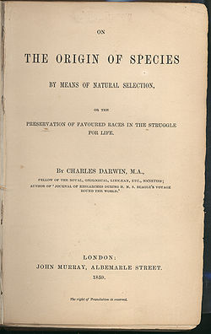
FOSSIL EVIDENCE LACKING
‘The geological record is extremely imperfect and this fact will to a large extent explain why we do not find intermediate varieties, connecting together all the extinct and existing forms of life by the finest graduated steps. He who rejects these views, on the nature of the geological record, will rightly reject my whole theory’
sixth (1901) edition of Darwin’s book, pages 341-342].

Slide 23
FOSSIL EVIDENCE LACKING
Lack of Transitional Forms
Use Caution
Transitional fossils are fossils which are thought to document the evolutionary change, or transition, of one species into another.
Evolutionists will brag that they have abundant evidence of transitions, but when pressed, the examples are almost always minor variations within a category, as expected within creation thinking, and thus certainly not proof of evolution.
Evolutionist may interpret information to fit their preconceived ideas. Challenge your friend to research supposed “transitional fossils” individually

Slide 24
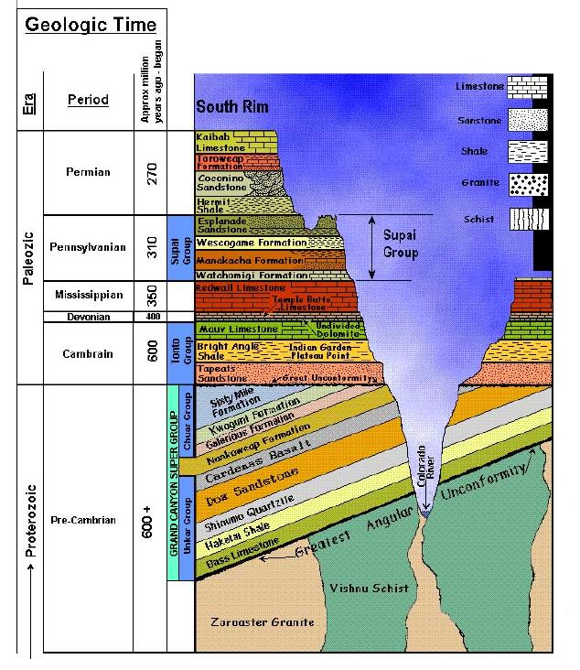
FOSSIL EVIDENCE LACKING
The problem of fossil layers
Cambrian Explosion
Geological Strata – Grand Canyon
MAMMALS/ BIRDS – 65mya
REPTILES – 248mya
AMPHIBIANS – 280mya
FISH – 408mya
at least two-thirds of all known animal phyla (28 out of the 42), all within a very brief period of geological time. 540mya
Single celled organisms – 3.9bya
Notes:
Another line of evidence concerns the order in which fossils are found buried. Fossils are generally found buried in a sequential order. The first fossilized fish appear buried below the first fossilized amphibians which appear below the first fossilized reptiles which appear below the first fossilized birds and mammals. This is consistent with the Darwinian model of origins which says that birds and mammals evolved from reptiles which evolved from amphibians which evolved from fish. The acronym to remember is FARM: Fish to Amphibian to Reptile to Mammal (and bird).
Not everything about the order in which fossils are found supports Darwin’s theory however. Near the bottom of the fossil record we find the Cambrian explosion, the sudden appearance of at least two-thirds of all known animal phyla (28 out of the 42), all within a very brief period of geological time. There is some debate as to how many of the remaining 14 phyla also appear during the Cambrian (some scientists say as many as 13 of the remaining 14). Regardless, it is clear that many of the major innovations to the basic structure of known animal forms occurred during this very brief, enigmatic period. This does not support Darwin’s theory of gradual innovation.
Illustration: FOOTBALL FIELD –
Goal line – first fossil of a microscopic, single celled organism
20 yard line – 40 yard line – Mid field – Opposite 20 - only singled celled organisms
Opposite 16 yard line – sponges – jellyfish – worms and then a stride later you find an explosion of fossils representing 2/3 of all known animal phyla including insects, crabs, starfish, sea urchins and vertebrates (Strobel, Case for a Creator, p. 44.)
http://www.enchantedlearning.com/subjects/Geologictime.html

Slide 25
FOSSIL EVIDENCE LACKING
Fossil dating based on geological strata
Geological strata dated according to fossil record
Fossil record explained according to evolutionary theory
Notes:
Sometimes, it is possible to determine age directly from the fossil. Many times however, fossils are to old to have their age directly measured. Instead, age can be determined from radioactive elements occurring within rock found in association with the fossils. http://snakefly.tripod.com/Date.html
For example, in a 1979 interview with *Dr. Donald Fisher, the state paleontologist for New York, Luther Sunderland, asked him: "How do you date fossils?" His reply: "By the Cambrian rocks in which they were found." Sunderland then asked him if this were not circular reasoning, and *Fisher replied, "Of course, how else are you going to do it?" (Bible Science Newsletter, December 1986, p. 6.)
"The rocks do date the fossils, but the fossils date the rocks more accurately. Stratigraphy cannot avoid this kind of reasoning . . because circularity is inherent in the derivation of time scales."—*J.E. O'Rourke, "Pragmatism vs. Materialism in Stratigraphy," American Journal of science, January 1976.
http://www.pathlights.com/ce_encyclopedia/Encyclopedia/12fos11.htm

Slide 26
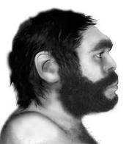
APE MEN FRAUDS
At one time it was thought that we came from the Neanderthal. Neanderthals were discovered from 1848 to 1856 and for years they were considered to be ape-men. But now we know, there's no argument here, that they're just plain ordinary people.
Notes:
http://emporium.turnpike.net/C/cs/emnh.htm

Slide 27
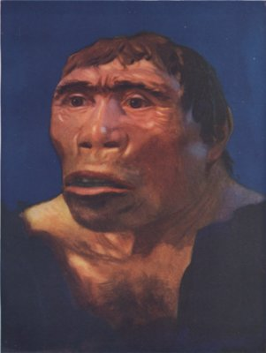
APE MEN FRAUDS
Java Man based on a leg bone, a skullcap, a jaw fragment and three teeth. Interestingly enough some of the teeth were old and some young. And the skull cap and leg bone were found a year apart and in locations 50 feet apart.
Notes:
In 1892 on the island of Java, he found a thigh-bone, which to all intents and purposes was like that of modern humans. About a year earlier in the same location he had found a large skull-cap, and later three teeth. These were not necessarily from the same individual: the skullcap and the leg-bone were about 15 meters (50 feet) apart.

Slide 28

APE MEN FRAUDS
In 1912 Piltdown man was “discovered’ in England. It was exposed in 1953 as a forgery, consisting of the lower jawbone of an orangutan that had been deliberately combined with the skull of a fully developed modern human.
Notes:
AKA Charles Dawson’s Dawn Man
http://www.talkorigins.org/faqs/piltdown.html

Slide 29
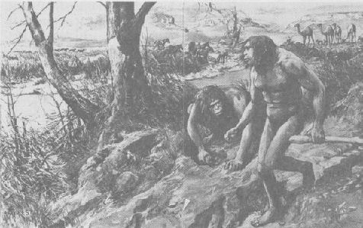
APE MEN FRAUDS
One tooth found on a farm in Nebraska ... one tooth. But, with a little imagination, the tooth was imagined to be part of a jawbone. The jaw bone part of a skull. The skull part of a skeleton and by the time the story hit the London newspaper, we not only had a picture of Nebraska man but we had a picture of Nebraska mom complete with fur.
Notes:
In 1922 a single tooth was found in Pliocine deposits in western Nebraska. Dr. Henry Fairfeild Osborn of Columbia University, head of the American Museum of Natural History, determined that this tooth had characteristics of chimpanzee, Pithecanthropus (Java man), and man. From this he concluded that this was a missing link. In England Sir Grafton Elliot Smith, F.R.S., Professor of Anatomy of Manchester, fully supported Osborn (Bowden 1977, 46).
http://emporium.turnpike.net/C/cs/emne.htm

Slide 30
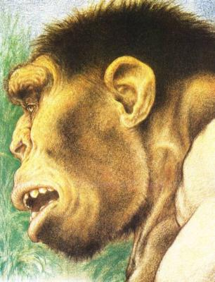
APE MEN FRAUDS
Peking Man found about 25 miles from Peking (Beijing), consisted mostly of skull fragments (only five skulls were intact enough to gauge the brain capacity) and teeth, with very few limb bones. All of the original bones were mysteriously "lost" between 1941 and 1945. (Fortunately, some excellent casts of the originals were made before their disappearance.)
Notes:
The evidence for this being a “missing link” is tenuous at best.
The original reconstruction of Peking Man was prepared by Dr. F. Weidenreich and Mrs. Lucille Swan in 1937 from the fossil remains of several different individuals found in the caves at Zhoukoudian, China. The Bone Clones replica of the Peking Man is easily obtainable today.
http://www.google.com/imgres?imgurl=http://www.cryptomundo.com/wp-content/homo_erectus_03_2061.jpg&imgrefurl=http://www.cryptomundo.com/cryptozoo-news/peking-man09/&h=400&w=306&sz=27&tbnid=xNpaLtJOMsF_eM:&tbnh=257&tbnw=197&prev=/images%3Fq%3Dpeking%2Bman%2Bpicture&hl=en&usg=__Xed-5dsVmeLry_yV1Ibd0D7k9Hw=&ei=Y6XlS-zXNcL98AbD56H3CQ&sa=X&oi=image_result&resnum=2&ct=image&ved=0CBoQ9QEwAQ

Slide 31
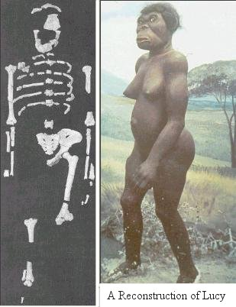
APE MEN FRAUDS
LUCY - Discovered in Ethiopia by Donald Johansson in 1974. It was dated at being three million years old. The scientists were not allowed to examine Lucy's bones up until 1982. When they finally did, They couldn't tell the difference between Lucy and a rainforest Chimpanzee that you might find in the San Diego Zoo.
Notes:
And then of course there was Lucy. This is one of my all time favorites ... discovered in Ethiopia by Donald Johansson in 1974. It was dated at being three million years old. It was diagrammed at the very "Y" that separates man from ape. Now Johansson is a humble man and as a humble man he claimed humbly that Lucy was the most important find made by anyone in the history of the entire human race. The media immediately made Johansson, then an assistant professor, a hero. In fact, he got his own institute for human biology at Berkley but there's more to the story. The scientists were not allowed to examine Lucy's bones up until 1982. When they finally did, guess what they found? They found out that you couldn't really tell the difference between Lucy and a rainforest Chimpanzee that you might find in the San Diego Zoo.
http://www.2christ.org/face/

Slide 32

CHANCE- AGAINST ALL ODDS
Borel’s law of probability state that if the odds of an event happening are worse than 1^50 it will never happen.
Harold Morowitz – 1^340,000,000
Carl Sagan – 1^2,000,000,000
Notes:
Morowitz was former professor of biophysics at Yale.
Sagan was a cosmologist/evolutionist at Cornell University.
http://www.scribd.com/doc/448517/Evolution-What-Are-the-Odds
A good way of looking at the incredible odds against a cell ever forming is to imagine one person picking one ticket per day (it would have to be daily) in a lottery drawing with the odds being one chance in 100,000,000 of being picked. And this person would have to be the winner every day for more than 1000 years, without ever missing even one day of winning.
Of course, it would be extremely unlikely for this one person to win it even two days in a row, ever. But to win it 375,000 days in a row... Well you can get the picture.
http://ezinearticles.com/?Understanding-Evolution-and-Its-Problems&id=3942514
Rick Ramashing and Sir Fred Hoyle calculated the probability for one cell to evolve by chance. The atheist/agnostic team found to their disbelief that it is 1 chance in 10 to the 40,000th power years just for one cell to evolve. Hoyle said, "The chance that higher life forms might have emerged in this way is comparable with the chance that 'a tornado sweeping through a junk-yard might assemble a Boeing 747 from the materials therein.' "[3] Does evolution have enough time? No.
http://www.trueauthority.com/cvse/fiftyreasons.htm

Slide 33
ENTROPY – A LAW THAT’S HARD TO BREAK
The whole universe of matter is running down, and ultimately will reduce itself to uniform chaos.
Evolution teaches that biology is constantly moving towards more order and more complexity.
Mutations are threats to a species rather than improvements.
Irreducible complexity does not allow for a gradual adaption of an organism.
Notes:
By irreducibly complex I mean a single system composed of several well-matched, interacting parts that contribute to the basic function, wherein the removal of any one of the parts causes the system to effectively cease functioning. An irreducibly complex system cannot be produced directly (that is, by continuously improving the initial function, which continues to work by the same mechanism) by slight, successive modifications of a precursor system, because any precursor to an irreducibly complex system that is missing a part is by definition nonfunctional. An irreducibly complex biological system, if there is such a thing, would be a powerful challenge to Darwinian evolution. (p. 39) http://www.talkorigins.org/faqs/behe.html

Slide 34
Summary
The Bible is very clear – God created the universe and all that is in it.
When dealing with someone who rejects the Biblical account, always remember the importance of truth and relationship.
Asking questions of the skeptic is often more effective than simply giving answers.
An intelligent response against evolution can be based on the acronym F A C E.

