Slide 1
How to Share Your Faith
4/18 – 6/20
5/16/2010
Answers To Those Who Object
Answers For Those Willing to Listen

Slide 2
Answers To Those Who Object
Introduction: Absolute Truth in a Relativistic Society – Exclusive Christian Claims are Offensive
Church History is Littered With Oppression and Violence
How Could a Loving God Allow Evil, Suffering, and Hell?
Evolution Explains Life – Who Needs God?
Other Objections
Notes:
So here is what we cover in the next 10 weeks. We will start with some of the major objections.
Since there are so many objections we could discuss, in class 5 we address the ones you want to discuss.

Slide 3
Answers For Those Willing to Listen
The Real Good News of the Gospel
Methods of Evangelism
Using Your Testimony to Share Your Faith
Sharing Your Faith to Different Faiths
The Big Picture of Missions
Notes:
For the last 5 classes we will focus more on practical approaches for personal evangelism starting with the definition of the gospel and ending with the progress of the gospel through out the world.

Slide 4
Other Objections
Barriers to Faith
The Bible – Can you really trust it?
The Bible – Can you really understand it?
The Bible – Can you really believe it?

Slide 5
Other Objections – Can You TRUST the BIBLE?
The questions here are…
Is the Bible a reliable source since we don’t have the original texts?
Is the Bible accurate historically?
Is the Bible Divine in origin?
Aren’t their contradictions in the Bible?
Notes:
We can address these questions by remembering the acronym MAPS and presenting some basic information to support your position of the Bible as being a reliable source for our faith today.

Slide 6
Other Objections – Can You TRUST the BIBLE?
M A P S
Manuscript Evidence
Archeological Evidence
Prophetic Evidence
Statistics

Slide 7
Can You TRUST the BIBLE?
MANUSCRIPT EVIDENCE
We have no original NT or OT manuscripts.
We do have over 24,000 Greek, Latin, and other NT manuscripts dated from 100 – 300 years after the originals and some fragments back to 50AD or earlier.
Compare With
Caesar—10 copies—1000 year gap
Tacitus—20 copies—1000 year gap
Plato—7 copies—1200 year gap
No other book is even a close second to the Bible on either the number or early dating of the copies.
Notes:
"Astounding" number of ancient manuscripts extant: 5,000 Greek manuscripts, 10,000 Latin and 9,000 other--totaling over 24,000 manuscript copies or portions of the New Testament. These are dated from 100 to 300 years after the originals. (There are no original manuscripts ["autographs"] extant, but the number and similarity of copies allows scholars to reconstruct the originals.)
http://www.faithfacts.org/search-for-truth/maps/manuscript-evidence

Slide 8
Can You TRUST the BIBLE?
MANUSCRIPT EVIDENCE
Author | Date Written | Earliest Copy | Time Span | Number of Copies | Accuracy of Copies
Aristotle | 384-322 B.C. | 1100 AD | 1400 years | 49 | -------------
Sophocles | 496-406 B.C. | 1000 AD | 1400 years | 193 | ----------
Iliad (Homer) | 900 BC | 400 BC | 500 years | 643 | 95%
NT | 50 – 100AD | 130AD | < 100 years | 5600+ Greek | 99.5%
Notes:
http://www.carm.org/manuscript-evidence - Chart
Homer's Iliad, the most renowned book of ancient Greece, is the second best-preserved literary work of all antiquity, with 643 copies of manuscript support discovered to date. In those copies, there are 764 disputed lines of text, as compared to 40 lines in all the New Testament manuscripts.
In fact, many people are unaware that there are no surviving manuscripts of any of William Shakespeare's 37 plays (written in the 1600's), and scholars have been forced to fill some gaps in his works. http://www.allaboutthejourney.org/bible-manuscripts.htm

Slide 9
Can You TRUST the BIBLE?
MANUSCRIPT EVIDENCE
Of the thousands of early manuscripts scholars have determined the internal consistency of the New Testament documents to be about 99.5% textually pure.
Within the 0.5% of passage with disputed purity, not one of them have an impact on any major doctrine of the faith.
"There is no body of ancient literature in the world which enjoys such a wealth of good attestation as the New Testament.“ F.F. Bruce.
Notes:
http://www.carm.org/manuscript-evidence
Also see http://home.earthlink.net/~ronrhodes/Manuscript.html

Slide 10
Can You TRUST the BIBLE?
OLD TESTAMENT Manuscript evidence
The Dead Sea Scrolls discovered in 1947 are dated from the third century B.C. to the first century A.D.
These manuscripts predate by 1000 years the previous oldest manuscripts. They represent every Old Testament book except Esther (as well as non-biblical writings).
There is word for word identity in more than 95% of the cases, and the 5% variation consists mostly of slips of the pen and spelling.
Notes:
http://www.faithfacts.org/search-for-truth/maps/manuscript-evidence

Slide 11
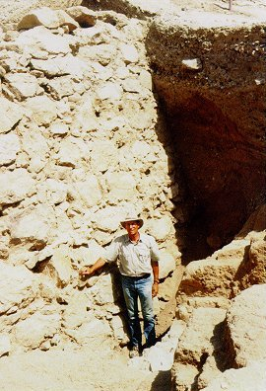
Can You TRUST the BIBLE?
Archeological Evidence
Joshua 6 – Walls of Jericho
The archaeological evidence supports the historical accuracy of the biblical account in every detail. Every aspect of the story that could possibly be verified by the findings of archaeology is, in fact, verified.
Notes:
http://www.answersingenesis.org/creation/v21/i2/jericho.asp
How they fell flat and could be climbed over…
The preservation of a short stretch of the lower city wall on the north side did not fall as everywhere else giving credence to the protection of Rahab’s house.
Excavations have shown that the bricks from the collapsed walls formed a ramp against the retaining wall so that the Israelites could merely climb up over the top. The Bible is very precise in its description of how the Israelites entered the city

Slide 12
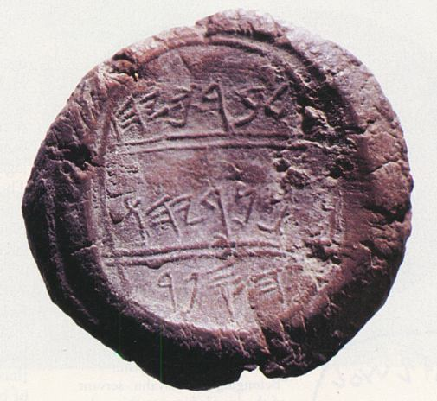
Can You TRUST the BIBLE? Archeological Evidence
Jeremiah’s Scribe
Seal of Baruch
In 1986, scholars identified an ancient seal belonging to Baruch, son of Neriah, a scribe who recorded the prophecies of Jeremiah (Jer. 45:1).
“This is the message which Jeremiah the prophet spoke to Baruch the son of Neriah, when he had written down these words in a book at Jeremiah's dictation, in the fourth year of Jehoiakim the son of Josiah, king of Judah, saying…”
Notes:
An archaeological find which verifies the historicity of the book of Jeremiah, is the discovery of the Seal of Baruch in 1975. Baruch was the scribe or emanuensis who wrote down the prophecies of Jeremiah. Read more about the Seal of Baruch at: http://home.att.net/~kmpope/SealofBaruch.html
In 1975, a collection of nearly 250 clay seals were found about 44 miles southwest of Jerusalem. These small lumps of clay that are impressed with a seal, in ancient times served as an official signature for an individual. The clay seals were then attached to documents to identify the sender. Amazingly, among the seals that were found were the names of three Biblical figures mentioned in the 36th chapter of the book of Jeremiah.
The first clay seal is impressed with the following inscription: Berekhyahu son of Neriyahu the scribe. This is the seal of Baruch son of Neriah who was the scribe to the prophet Jeremiah. Baruch's full name must have been Berekhyahu. The suffix (yahu) in the ancient Hebrew language is a form of Yahweh (God). The name Baruch means "the blessed." Berekhyahu means "the blessed of Yahweh."

Slide 13
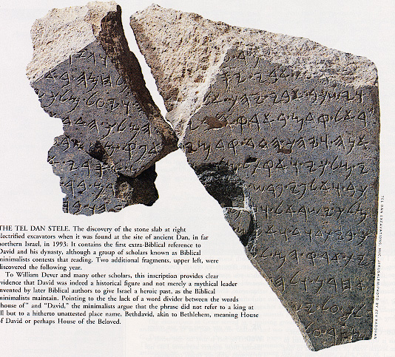
Can You TRUST the BIBLE? Archeological Evidence
First Reference to House of David
Tel Dan Inscription
In 1993, archaeologists uncovered a 9th century B.C. inscription at Tel Dan. The words carved into a chunk of basalt refer to the "House of David" and the "King of Israel."
Notes:
The House of David Inscription (also known as the “Tel Dan Inscription”) was discovered in 1994 during excavations at the ancient city of Dan. It is considered by many to be the first reference to the "House of David" discovered outside the biblical text.
http://www.allaboutarchaeology.org/the-house-of-david-inscription-faq.htm
It was erected by an Aramaean king and contains an Aramaic inscription commemorating victories over local ancient peoples including "Israel" and the "House of David." Its author is unknown, but may be a king of Damascus, Hazael or one of his sons.
The inscription generated excitement among biblical scholars and biblical archaeologists because the letters 'ביתדוד' are identical to the Hebrew for "house of David."
http://en.wikipedia.org/wiki/Tel_Dan_Stele

Slide 14
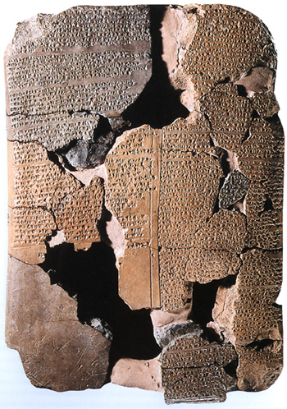
Can You TRUST the BIBLE?
Archeological Evidence
Tablet at Bogazkoy
Hittites Discovered
The Hittites were once thought to be a Biblical legend, until their capital and records were discovered at Bogazkoy, Turkey.
Notes:
In the 19th and 20th centuries archaeologists hit the jackpot, not only identifying extra biblical references to the Hittite civilization, but by actually finding and excavating the ancient Hittite capital city of Hattusa (modern day Boðazköy in northern Turkey). The rediscovery of this ancient civilization vindicated the Biblical record.
http://www.allaboutarchaeology.org/hittite-faq.htm

Slide 15
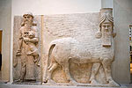
Can You TRUST the BIBLE?
Archeological Evidence
Sargon’s Palace
Winged Bull of Sargon
It was once claimed there was no Assyrian king named Sargon as recorded in Isaiah 20:1, because this name was not known in any other record.
Then, Sargon's palace was discovered in Khorsabad, Iraq. The very event mentioned in Isaiah 20, his capture of Ashdod, was recorded on the palace walls. What is more, fragments of a stela memorializing the victory were found at Ashdod itself.
Notes:
http://www.christiananswers.net/q-abr/abr-a008.html
Isaiah 20:1 - In the year that the commander came to Ashdod, when Sargon the king of Assyria sent him and he fought against Ashdod and captured it,

Slide 16
Can You TRUST the BIBLE?
Archeological Evidence
“…archaeology has confirmed not dozens, but hundreds and hundreds of details from the biblical account of the early church. Even small details have been corroborated, like which way the wind blows, how deep the water is a certain distance from shore, what kind of disease a particular island had, the names of local officials, and so forth.” Norm Geisler citing Colin J. Hemer – Roman historian
Sir William Ramsay – Prominent historian/former skeptic
A.N.Sherwin-White – Oxford historian
William F. Albright – American School of Oriental Research
Notes:
Case For Faith, pp. 130 and 131.
Hemer’s book, The Book of Acts in The Setting of Hellenistic History .
Sir William Ramsay started as a skeptic, but after studying Acts he concluded Acts to be accurate in detail.
Sherwin-White – “For Acts the confirmation of historicity is overwhelming…”
Archeologist Albright concluded after 40 years of research - moved from being a critic to assenting to the historical accuracy of the NT.

Slide 17
Can You TRUST the BIBLE?
Archeological Evidence
“There have been thousands-not hundreds- of archaeological finds in the Middle east that support the picture presented in the biblical record”
Discoveries have confirmed…
King David, the patriarchs, Sodom and Gomorrah, Jewish captivity, every Assyrian King, Solomon’s temple, Hittites, Philistine gods, and much more.
“If we can trust the Bible when it’s telling us about straightforward earthly things that can be verified, then we can trust it in areas where we can’t directly verify in in an empirical way” Norman Geisler - author of more than 50 books
Notes:
Geisler as quoted in The Case For Faith, p. 251.

Slide 18
Can You TRUST the BIBLE?
Prophetic Evidence
Born of a virgin (Isaiah 7:14; Matthew 1:21-23)
A descendant of Abraham (Genesis 12:1-3; 22:18; Matthew 1:1; Galatians 3:16)
Of the tribe of Judah (Genesis 49:10; Luke 3:23, 33; Hebrews 7:14)
Of the house of David (2 Samuel 7:12-16; Matthew 1:1)
Born in Bethlehem (Micah 5:2, Matthew 2:1; Luke 2:4-7)
Taken to Egypt (Hosea 11:1; Matthew 2:14-15)
Herod´s killing of the infants (Jeremiah 31:15; Matthew 2:16-18)
Notes:
330 + Messianic prophecies in the OT, not to mention about 2500 prophecies in the entire Bible. Only 500 more to be fulfilled.

Slide 19
Can You TRUST the BIBLE?
Prophetic Evidence
Anointed by the Holy Spirit (Isaiah 11:2; Matthew 3:16-17)
Heralded by the messenger of the Lord (John the Baptist) (Isaiah 40:3-5; Malachi 3:1; Matthew 3:1-3)
Would perform miracles (Isaiah 35:5-6; Matthew 9:35)
Would preach good news (Isaiah 61:1; Luke 4:14-21)
Would minister in Galilee (Isaiah 9:1; Matthew 4:12-16)
Would cleanse the Temple (Malachi 3:1; Matthew 21:12-13)
Would first present Himself as King 173,880 days from the decree to rebuild Jerusalem (Daniel 9:25; Matthew 21:4-11)
Would enter Jerusalem as a king on a donkey (Zechariah 9:9; Matthew 21:4-9)

Slide 20
Can You TRUST the BIBLE?
Prophetic Evidence
Die a humiliating death (Psalm 22; Isaiah 53) involving:
  rejection (Isaiah 53:3; John 1:10-11; 7:5,48)
  betrayal by a friend (Psalm 41:9; Luke 22:3-4; John 13:18)
  sold for 30 pieces of silver (Zechariah 11:12; Matthew 26:14-15)
  silence before His accusers (Isaiah 53:7; Matthew 27:12-14)
  being mocked (Psalm 22: 7-8; Matthew 27:31)
  beaten (Isaiah 52:14; Matthew 27:26)
  spit upon (Isaiah 50:6; Matthew 27:30)

Slide 21
Can You TRUST the BIBLE?
  Prophetic Evidence
  piercing His hands and feet (Psalm 22:16; Matthew 27:31)
  being crucified with thieves (Isaiah 53:12; Matthew 27:38)
  praying for His persecutors (Isaiah 53:12; Luke 23:34)
  piercing His side (Zechariah 12:10; John 19:34)
  given gall and vinegar to drink (Psalm 69:21, Matthew 27:34, Luke 23:36)
  no broken bones (Psalm 34:20; John 19:32-36)
  buried in a rich man’s tomb (Isaiah 53:9; Matthew 27:57-60)
  casting lots for His garments (Psalm 22:18; John 19:23-24)

Slide 22
Can You TRUST the BIBLE?
Prophetic Evidence
Would be rejected by Jews (Psalm 118:22; I Peter 2:7)
Would rise from the dead!! (Psalm 16:10; Mark 16:6; Acts 2:31)
Ascend into Heaven (Psalm 68:18; Acts 1:9)
Would sit down at the right hand of God (Psalm 110:1; Hebrews 1:3)
  These predictions were written by multiple authors, in numerous books, over approximately 1,000 years.
  Even the most liberal critics admit that the prophetic books were completed some 400 years before Christ.
  Not to mention the more than 1700 non messianic prophecies that have been fulfilled.
Notes:
http://www.allabouttruth.org/messianic-prophecy.htm - List of Messianic prophecies
http://home.earthlink.net/~ronrhodes/Jews.html
Yes, one could possibly find one or two prophecies fulfilled in other men, but not all 61 major prophecies! In fact the chance of one man fulfilling even eight prophecies is 1 in 10 to the 17th power (1 in 100,000,000,000,000,000) This has been illustrated by imagining placing 100,000,000,000,000,000 silver dollars on the State of Texas which would result in two feet "sea" of silver wherever you tread! Now it where the odds get interesting. Mark one of the silver dollars distinctively and throw it into the state. Stir it all up and blindfold a man who has one pick to select the marked coin. That's the odds against anyone fulfilling only 8 prophecies, much less what most authorities feel is something like 330 plus Old Testament prophecies in some way fulfilled in the Messiah. To phrase it another way, these incredible odds just illustrated are the same chance that the OT prophets would have had of writing eight prophecies and having them all come true in any one man providing they wrote them in their own wisdom. One can conclude that the fulfillment of even just eight prophecies proves that God inspired the writing of these prophecies to a definiteness which lacks only one chance in 10 to the 17th power! The odds against all 330 plus OT prophecies being fulfilled in one man cannot even be reasonably illustrated, as they are so high!
http://preceptaustin.org/2_timothy_authority_of_god's_word.htm#odds
http://www.reasons.org/fulfilled-prophecy-evidence-reliability-bible - non messianic prophecies, Hugh Ross

Slide 23
Can You TRUST the BIBLE?
Statistical Evidence
The Bible was written
over a span of 1500 years
by forty different human authors - shepherds, military leaders, kings, priests, farmers, tax collectors, fishermen, etc
In a variety of counties - Israel, Babylon (now Iraq), Persia (now Iran), Italy, and Greece, etc
in three different languages (Hebrew, Aramaic, and Greek)
on hundreds of subjects
in a variety of literary genres – poetry, historical narrative, law, prophecy, epistles, apocalyptic, etc
Notes:
http://www.equip.org/articles/bible-reliability
in a number of different countries, like, Israel, Babylon (now Iraq), Persia (now Iran), Italy, and Greece.
of many different occupations: shepherd, military leader, king priest, farmer, tax collector, fishermen, tent maker, physician, prophets and apostles.

Slide 24
Can You TRUST the BIBLE?
Statistical Evidence
And yet there is one consistent theme that runs through it all God’s redemption of humankind
Clearly, Statistical probability is a powerful indicator of the trustworthiness of Scripture.

Slide 25
Can You Trust the Bible?
A word about contradictions
Most alleged contradictions can be answered by..
understanding the context
interpreting unclear passages in light of clear ones
understanding the literary genre
recognizing certain passages as complementary
recognizing the antinomies of scripture
Understanding the in intricacies of the original language
Most people cannot name a contradiction in the Bible – if so, ask what it is – look up the passages and read them together – ask your friend to explain the contradiction they see – give an answer if you have one –if not…
Don’t assume that there is no answer if you have no answer. Always have a humble spirit when dealing with tough questions.
The toughest contradiction to overcome could be the one between your attitude and your friends question.
Notes:
http://atheismexposed.tripod.com/bible_contradictions.htm - a good resource page

Slide 26
Can You Trust the Bible?
Examples of alleged contradictions
Death of Judas
Matthew 27:3-8 - and he went away and hanged himself
Acts 1:16-19 - and falling headlong, he burst open in the middle and all his bowels gushed out.
Notes:
http://contenderministries.org/discrepancies/contradictions.php#17 - listing of common alleged contradictions and answers for them.
This is an example of some of the alleged contradictions……
The Bible is riddled with repetitions and contradictions, things that the Bible bangers would be quick to point out in anything that they want to criticize. For instance, Genesis 1 and 2 disagree about the order in which things are created, and how satisfied God is about the results of his labors. The flood story is really two interwoven stories that contradict each other on how many of each kind of animal are to be brought into the Ark--is it one pair each or seven pairs each of the "clean" ones? The Gospel of John disagrees with the other three Gospels on the activities of Jesus Christ (how long had he stayed in Jerusalem--a couple of days or a whole year?) and all four Gospels contradict each other on the details of Jesus Christ's last moments and resurrection. The Gospels of Matthew and Luke contradict each other on the genealogy of Jesus Christ's father; though both agree that Joseph was not his real father. Repetitions and contradictions are understandable for a hodgepodge collection of documents, but not for some carefully constructed treatise, reflecting a well-thought-out plan.
http://www.infidels.org/library/modern/jim_meritt/bible-contradictions.html

Slide 27
Can You Understand the BIBLE?
The questions are…
If there are there so many different denominations with different interpretations, how can anyone understand for sure what the Bible really says?
Isn’t that just your interpretation?

Slide 28
Can You UNDERSTAND the BIBLE?
From the outside, various Christian churches and traditions can look extremely different.
Granted…
Christianity is the faith that is most spread across the cultures and regions of the world.
Theological rifts have occurred over the centuries.
Eastern Greek and western Roman division – 11th century
Roman Catholic and Protestant church – 16th century
Various divisions in the Protestant church
Notes:
Reason for God, Keller, p. 120ff.

Slide 29
Can You UNDERSTAND the BIBLE?
Despite the vast cultural and theological divisions among Christian churches, they all hold to assent to the creeds of the 1st thousand years of church history.
Apostle’s Creed Nicene Creed
Chalcedonian Creed Athanasian Creed
They all believe in ….
Triune God……Fallen State of Man…Deity and Humanity of Jesus…Salvation Through the Death and Resurrection of Christ by Grace…Establishment of the Church to Share God’s Message of Salvation…The Return of Christ to Abolish Evil and Renew the Earth

Slide 30
Can You UNDERSTAND the BIBLE?
The main teachings of the Bible are the clear and universally accepted doctrines in Christian churches.
There are major doctrinal differences among Christian churches….but the question is…can we interpret the Bible adequately enough to understand its message to us?
“That’s just your interpretation,”
“Well, then, what’s your interpretation?” Ask them to show you just how their interpretation fits the language and context of the bible better.
Often, you find that the person is just making excuses to avoid having a close encounter with the clear teachings of the Word of God

Slide 31
Can You BELIEVE the BIBLE?
The Question Are…
Why is it hard to believe the Bible for most people?
What is faith?
Can I still have doubts and have faith?

Slide 32
Can You BELIEVE the BIBLE?
Psalm 19: 1-4a - The heavens declare the glory of God; the skies proclaim the work of his hands. 2 Day after day they pour forth speech; night after night they display knowledge. 3 There is no speech or language where their voice is not heard. 4 Their voice goes out into all the earth…
“If we need an atheist for a debate, I go to the philosophy department. The physics department isn’t much use.”
Mathematical Physicist Robert Griffiths
Why do people still fail to believe?
Notes:
Case for Christ, p. 140.

Slide 33
Can You BELIEVE the BIBLE?
FTB Etiologies
Rebellion– “I’m not going to let somebody run my life, tell me what to do, and tell me how to think”
Disappointment – this may stem from a personal disappointment with God like the loss of loved one or a personal illness
Personal for family wounds – such as abuse as a child, betrayal of a spouse, business failure
Season of Life issues – Some people are just too busy to stop and think about faith
Fear of commitment – In a narcissistic society, we prefer the freedom to keep our options open

Slide 34
Can You BELIEVE the BIBLE?
FT B Etiologies
Intellectual objections - usually a smoke screen for the real issues of doubt in a person’s life.
People mix up faith with feelings - faith is not some spiritual high that makes us immune to disappointment and failures.
People think faith means you can no longer have any doubts.
Bottom line – Faith is a decision
John 12:37 Even after Jesus had done all these miraculous signs in their presence, they still would not believe in him.
Notes:
Mark 9:21 – Jesus asked the boy's father, "How long has he been like this?" "From childhood," he answered. 22 "It has often thrown him into fire or water to kill him. But if you can do anything, take pity on us and help us." 23 " 'If you can'?" said Jesus. "Everything is possible for him who believes." 24 Immediately the boy's father exclaimed, "I do believe; help me overcome my unbelief !"
Abraham – “father of faith” had doubts, did not always to the right thing, and often had impure motives for his action, but….he never gave up on his will to follow God.
Note John 12: 42 – “…But because of the Pharisees they would not confess their faith for fear they would be put out of the synagogue. 43 for they loved praise from men more than praise from God.”

Slide 35
Can You BELIEVE the BIBLE?
Faith is a choice we must make without having all the complete information we would like to have. It is not a complete knowledge about a situation.
Now faith is the substance of things hoped for, the evidence of things not seen (Hebrews 11:1).
Faith is a gift from God
If anyone chooses to do God's will, he will find out whether my teaching comes from God or whether I speak on my own (John 7:17)
Notes:
“If faith never encounters doubt, if truth never struggles with error, if good never battles with evil, how can faith know its own power? In my pilgrimage, if I have to choose between a faith that has stared doubt in the eye and made it blink, or a naïve faith that has never known the firing line of doubt, I will choose the former ever time”
Gary Parker… The Gift of Doubt. See Case for Faith, p. 243.

Slide 36
Can You BELIEVE the BIBLE?
Faith is only as good as the object in which it is placed.
Faith is an experiment
Taste and see that the LORD is good; blessed is the man who takes refuge in him (Psalm 24:8)
Faith is a verb
As we begin with Christ in faith, God begins to validate it. The further we follow Him in the journey of our life, the more we know it is true.
"Therefore everyone who hears these words of mine and puts them into practice is like a wise man who built his house on the rock (Mt 7:24)

Slide 37
The Real Good News of the Gospel
Dr. Torrey Robinson

